Slide 1
An Overview of Software Design
Parinya Ekparinya
Parinya.Ek@kmitl.ac.th

Slide 2
What is “Software Design” ?

Slide 3
Definition in the 70s
Nowadays, it is called “UX and UI Design”
During an interview with David E. Liddle in 1978, he said:
“Software design is the act of determining the user’s experience with a piece of software. It has nothing to do with how the code works inside, or how big or small the code is. The designer's task is to specify completely and unambiguously the user’s whole experience.... The most important thing to design properly is the user's conceptual model. Everything else should be subordinated to making that model clear, obvious, and substantial. That is almost exactly the opposite of how most software is designed.”

Slide 4
Definition in the 90s
The Association for Software Design (ASD) membership brochure offers a definition:
“Software design sits at the crossroads of all the computer disciplines: hardware and software engineering, programming, human factors research, ergonomics. It is the study of the intersection of human, machine, and the various interfaces—physical, sensory, psychological—that connect them.”
Not quite right… This is now “HCI”

Slide 5
Definition in 21st Century
Stated in “A science of design for software-intensive systems” by Peter A. Freeman and David Hart in 2004:
“Design encompasses all the activities involved in conceptualizing, framing, implementing, commissioning, and ultimately modifying complex systems, not just the activity following requirements specification and before programming, as it might be translated from a stylized software engineering process.”
This sounds better but there are 2 aspects!!

Slide 6
All the activities involved in conceptualizing, framing, implementing, commissioning, and ultimately modifying complex systems
The activity following requirements specification and before programming
The subject partly covers these!!

Slide 7
Requirement elicitation and analysis
Architectural design
Detailed design
Coding
Testing
Deployment
Maintenance

Slide 8
Architecture and Detailed Design
Software design can be partitioned into:
Architectural design
Detailed design
Some might even suggest 3 design levels:
Architectural design
High-level design
Detailed design
In practice, it is difficult to differentiate between these levels.

Slide 9
What is “Software Architecture”?

Slide 10
What comes to your mind when you hear the word “ARCHITECTURE”?

Slide 11
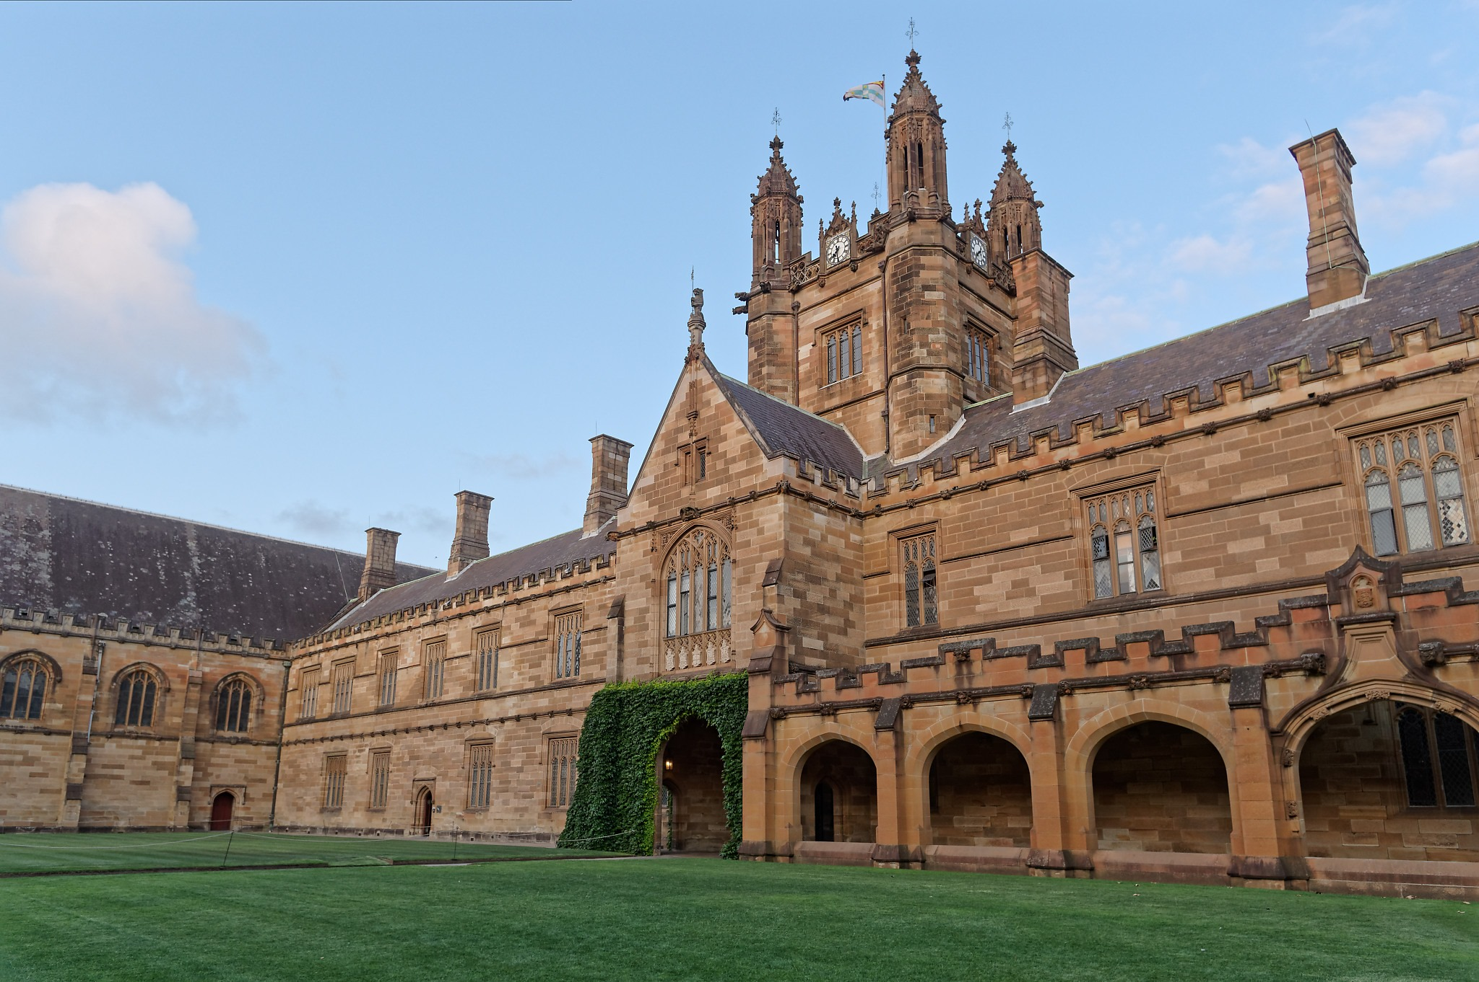

Slide 12
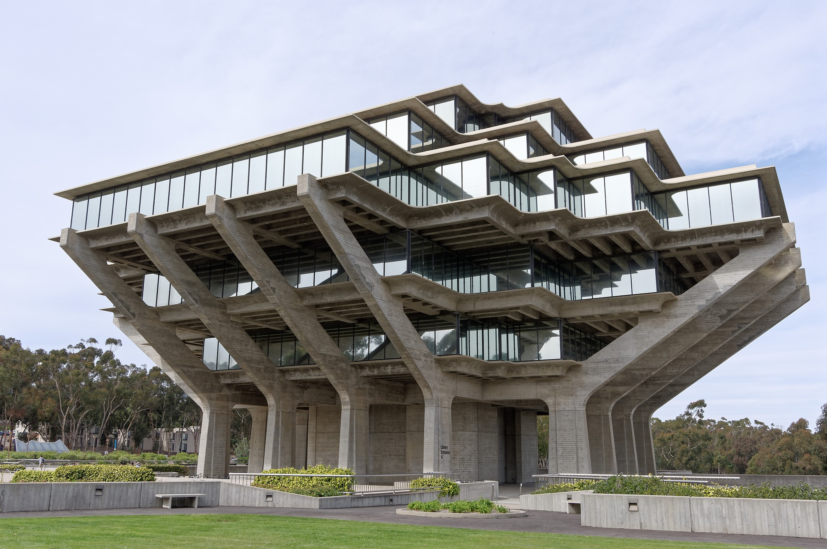

Slide 13
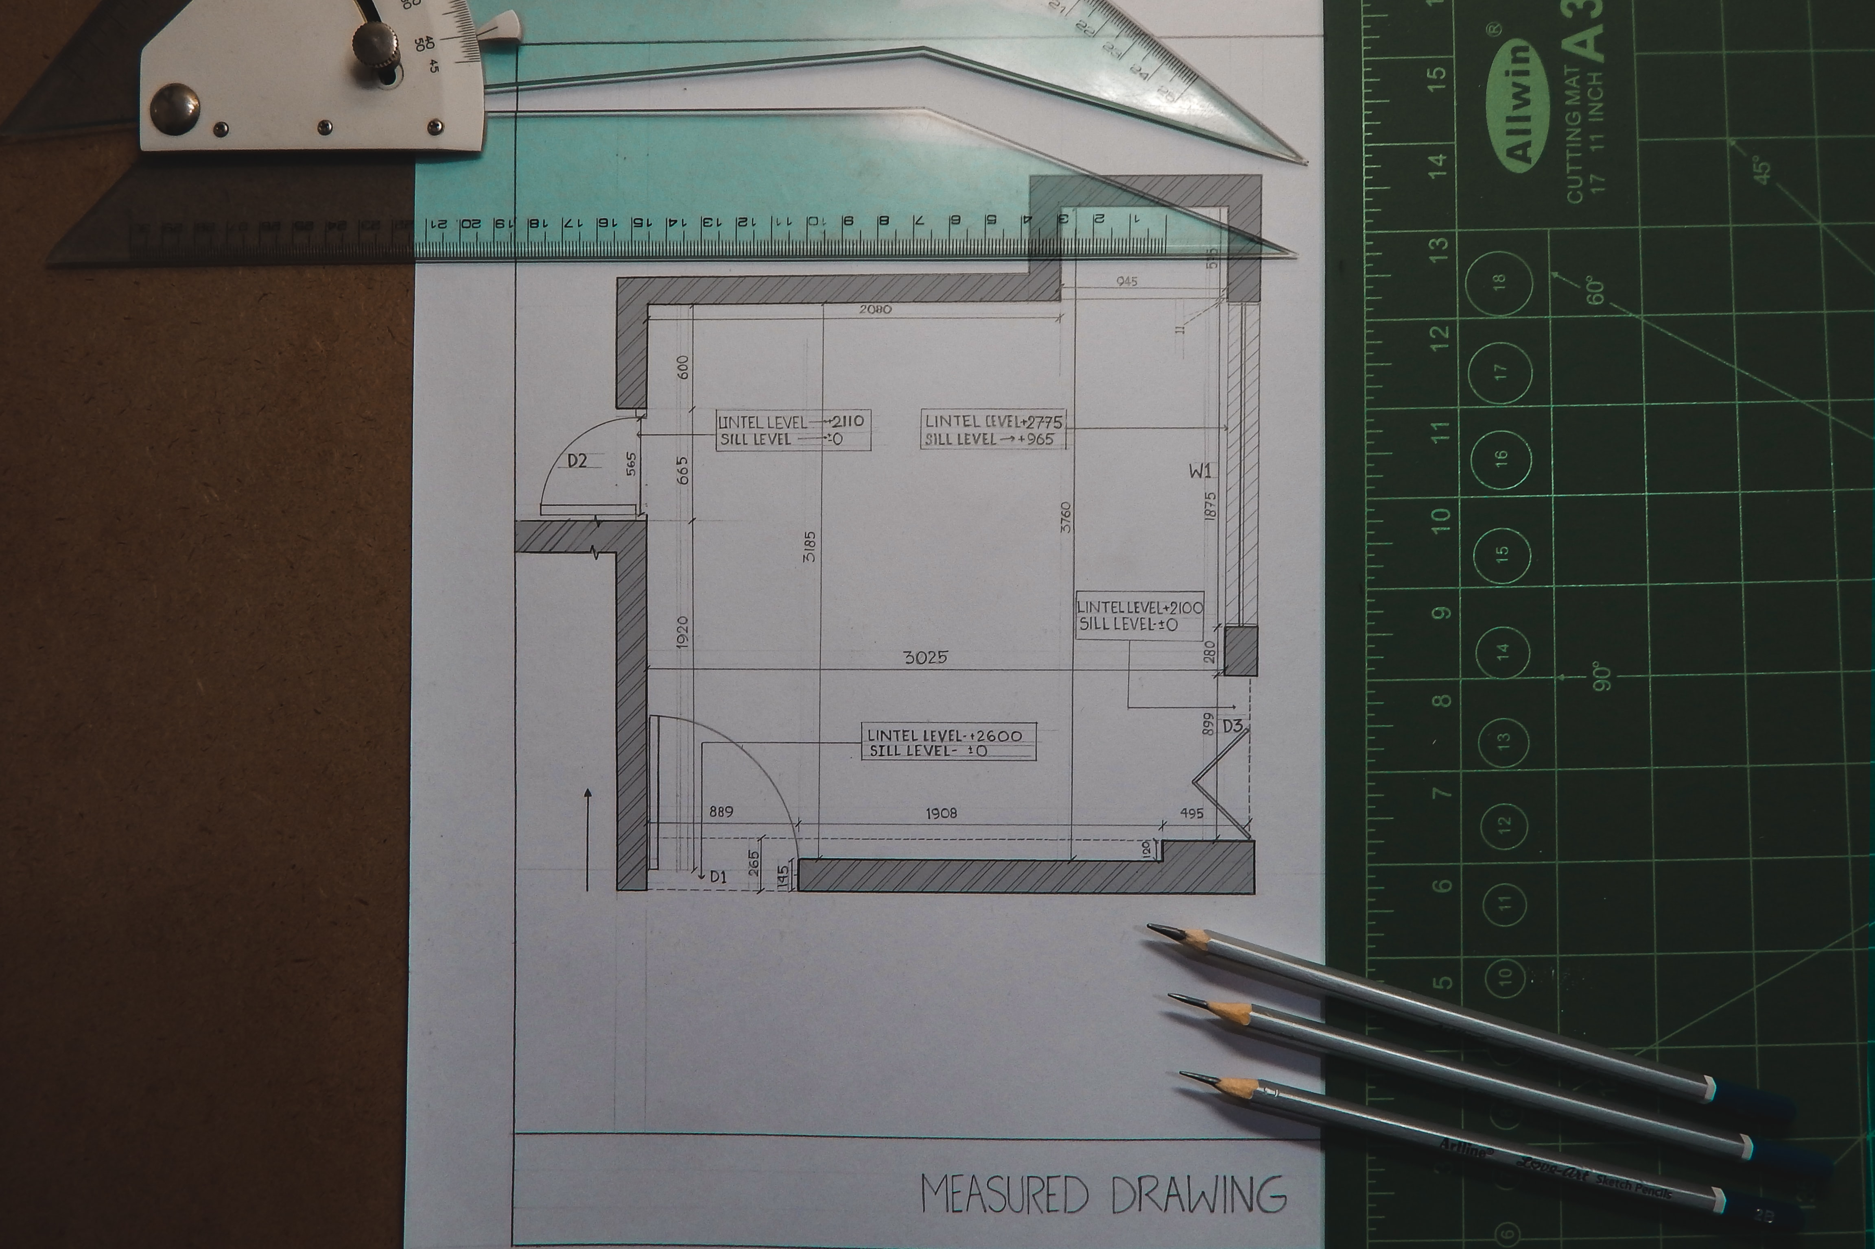
Photo by SOHAM BANERJEE on Unsplash

Slide 14
Definition of Software Architecture
One of the most popular definitions is from the Software Engineering Institute (Clements et al., 2010):
“The software architecture of a system is the set of structures needed to reason about the system, which comprise software elements, relations among them, and properties of both.”

Slide 15
Why is (software) architecture important?
Architecture acts as the skeleton of a system
Architecture influences quality attributes
Architecture is (mostly) orthogonal to functionality
Architecture constrains systems
Fairbanks, G. (2010). Just enough software architecture: a risk-driven approach. Marshall & Brainerd.

Slide 16
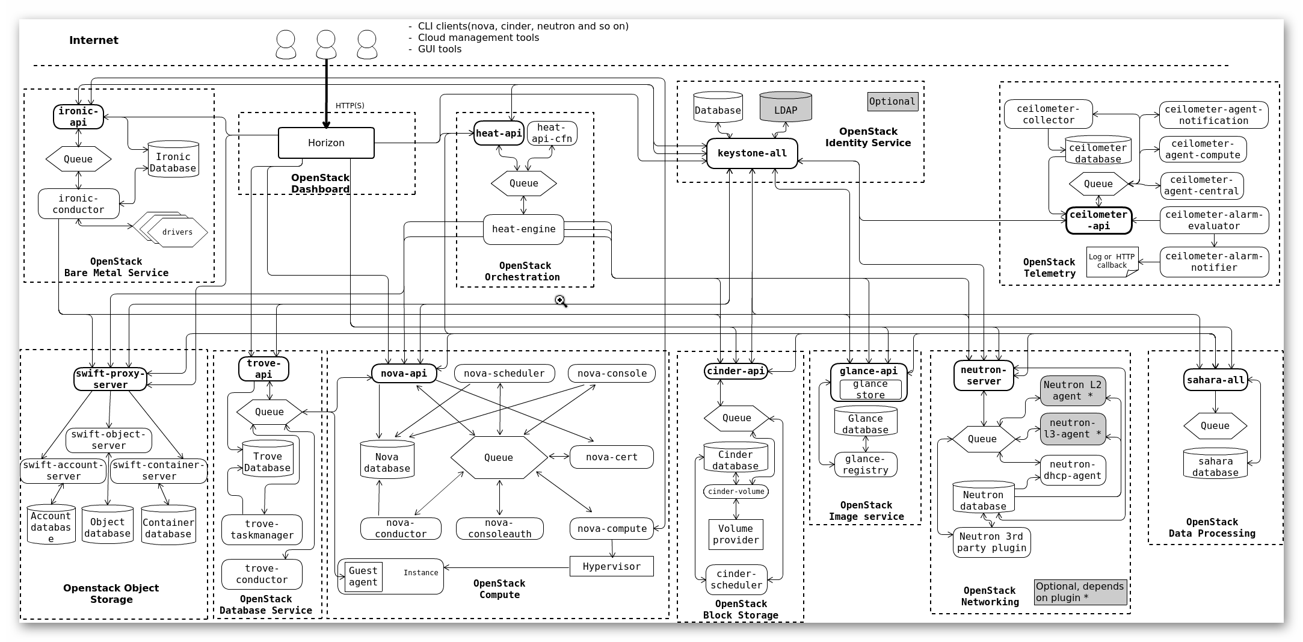
Architecture acts as the skeleton of a system
https://docs.openstack.org/install-guide/_images/openstack-arch-kilo-logical-v1.png

Slide 17
Architecture influences quality attributes
Access
control
Client
Proxy
Data Store
Client
Data Store
Data
masker
Given that a proxy performs both access control and data masking, please consider the followings:
Caching for performance improvement
Replacement of access control
Scaling up a data masker

Slide 18



Architecture is (mostly) orthogonal to functionality
When the architecture is poorly matched to the functionality, however, developers will struggle against it.

Slide 19
Architecture constrains systems
A train is constrained by its tracks!!
Procedural programming
Edgar Dijkstra: Go To Statement Considered Harmful https://homepages.cwi.nl/~storm/teaching/reader/Dijkstra68.pdf
For example: Pascal, C
Functional Programming
Functions are treated as first-class citizens
Immutable Data Structures — Once created their values never change!
For example: LISP, Erlang, Haskell

Slide 20
When is (software) architecture important?
Small solution space
High failure risk
Difficult quality attributes (to be discussed in later weeks…)
New domain
Product lines (common factors)
Fairbanks, G. (2010). Just enough software architecture: a risk-driven approach. Marshall & Brainerd.

Slide 21
Small solution space: (Venn diagram illustration)
U
U
Solution Space
Solution Space

Slide 22


High failure risk
Photo by Mathias P.R. Reding on Unsplash
Photo by Alex Azabache on Unsplash

Slide 23
New domain
Meaning it is new to you. It does not need to be an innovation!!
For instance, when you need to develop your first app on Android, you may need to pay more attention to its architecture even though you have already created a dozen web applications before.
In other words, your knowledge and experience are valuable!!

Slide 24
Product lines (common factors)
Some set of products share a common architecture.
The shared architecture may easily support some kinds of product variations, but difficultly support others.
For instance, a cross-platform application might be easily upgraded on Linux, but its Windows based counterpart is almost impossible to change.

Slide 25
What is “Detailed Design”?

Slide 26
What comes to your mind when you hear the word “DETAIL”?

Slide 27
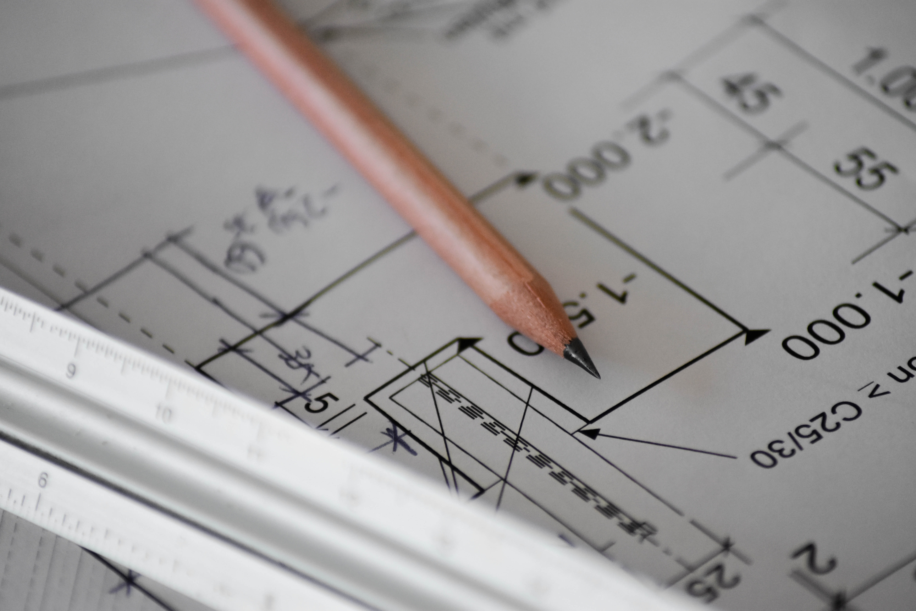
Photo by Sven Mieke on Unsplash

Slide 28
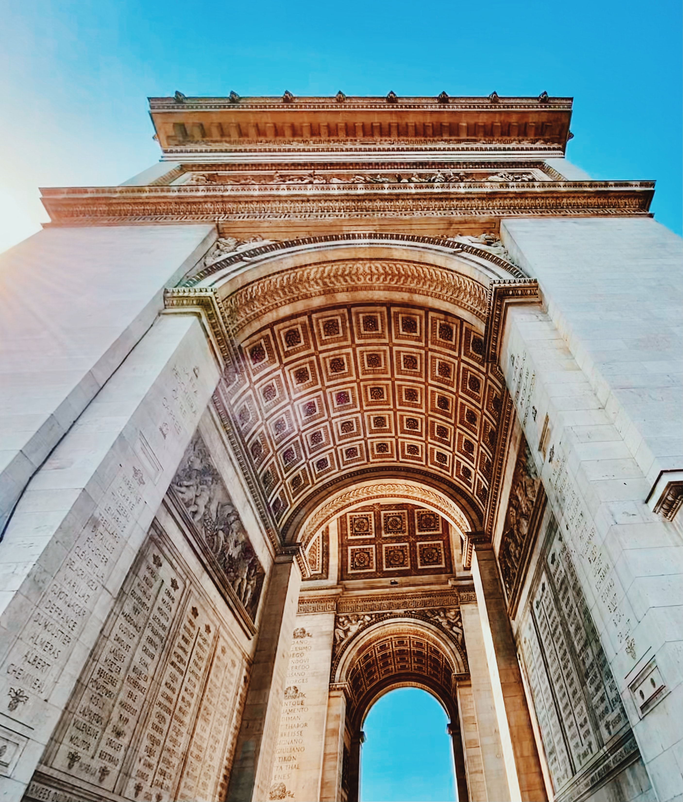

Photo by Andor on Unsplash
Photo by Jan Kopřiva on Unsplash

Slide 29

Photo by Nik Nikolla on Unsplash

Slide 30
What is detailed design?
Basically, it covers the rest of design decisions.
We cannot cover them all !!
Development tools
Programming languages
Programming frameworks and libraries
Components and their organization
Data structures
Classes
Methods
Interaction between components, e.g., communication protocols
User interfaces
Etc.
This is what we focus on!!

Slide 31
Design of components and their organization
The design of components directly affects quality attributes, such as:
To tolerate change
Easy to understand
To be used in many software systems
Some design principles to avoid common issues:
KISS – Keep It Simple Stupid
GRASP
SOLID principles

Slide 32
Design Process (in general !!)

Slide 33
Design Process
Designer’s decisions
Design object
Design Process
Design outcome
Constraints

Slide 34
Development process variations
Is there up-front design?
What is the nature of the design
planned/evolutionary
redesign allowed
How is work prioritized across iterations?
Process | Up-front design | Nature of design | Prioritization of work
Waterfall | Big Design Up Front | Planned design No redesign | Open
Incremental | Optional | Planned design & redesign allowed, Evolutionary design | Often feature-centric
Agile | None | Evolutionary design | Highest customer value first

Slide 35
Is software architecture and design less important than it used to be years ago? If so, why?

Slide 36
Summary
A variety of informal definition of software design
Architecture
What & Why
Detailed design
What & Why (partly)
“How” will be discussed in a few weeks later…
Design Process
Variations

